Slide 1

Taking FlashStack CVDs to the Next Level – with Infrastructure as Code
Joe Houghes
Senior Solutions Architect (FlashStack)
Pure Storage

Slide 2


Who am I?
20 years - customer, partner, service provider experience
Co-leader - PowerShell & VMware User Groups
Find me: Orange hat, big grin and the loud "Howdy Y'all."
I have little shame, and try to share my learnings with others
Don’t let IaC scare you

Slide 3

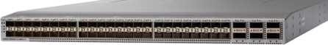
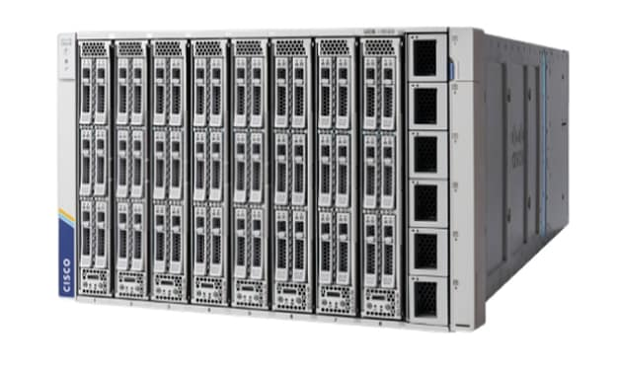



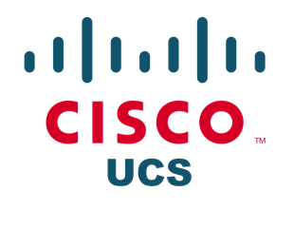


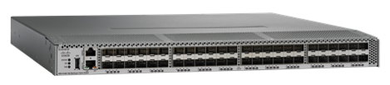

What is FlashStack?
NEXUS SWITCHES
(Ethernet)
MDS SWITCHES
(Fibre Channel)
#1 UCS-based full stack solution!
Notes:
FlashStack provides a dramatic simplification of the underlying components, and making them stateless is what makes that possible
The heart of this is to start with stateless servers and storage which are the underlying hardware platforms.
These are each best of breed in their respective component layer.
Servers that are stateless and flexible so that we can swap out the physical hardware without interrupting the logical VMs that are running within it
Likewise with a highly optimized and simplified storage that is stateless
This no tiny accomplishment!

Slide 4


The Old & New UCS
UCS B200 + UCSM
UCS X-Series + Intersight

Slide 5
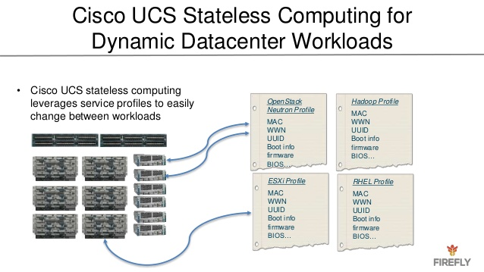
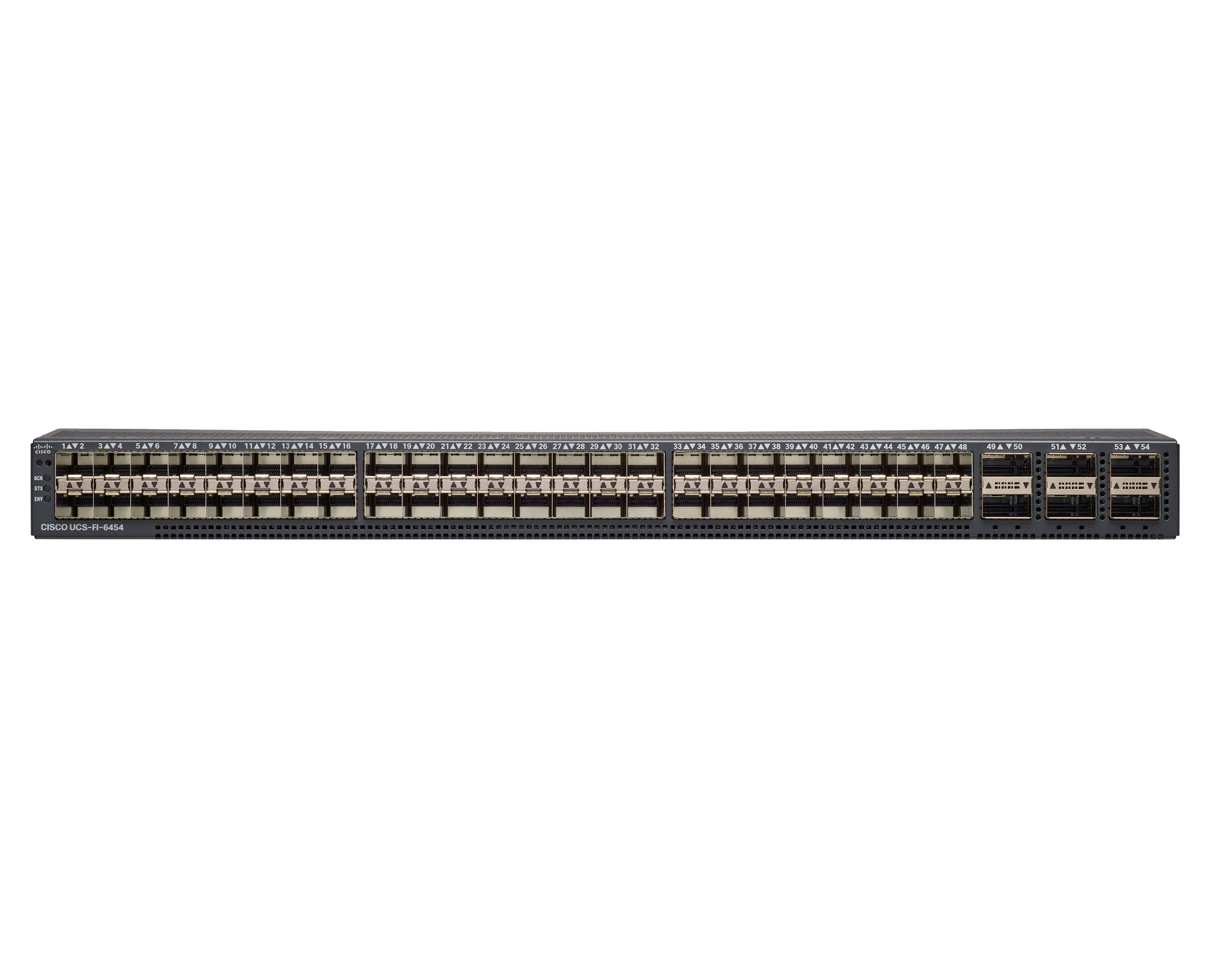

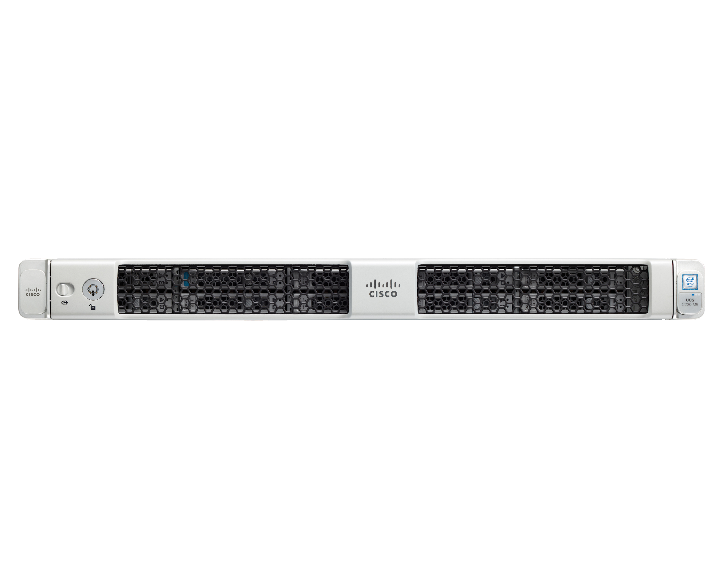
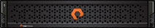

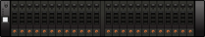
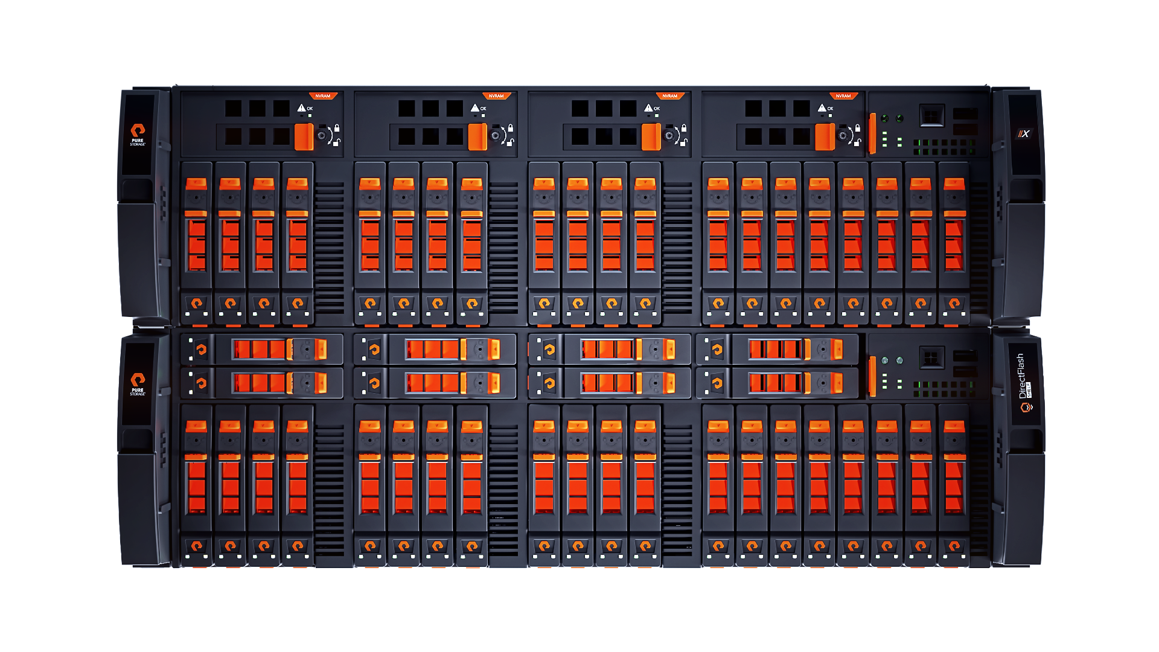
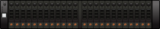
STATELESS ARCHITECTURE
ABSTRACT HARDWARE INTO SOFTWARE TO ALLOW FOR NON–DISRUPTIVE CHANGES
UCS hardware defined in Service Profile
MAC, WWN, UUID, Boot, Firmware, BIOS etc.
FlashArray hardware defined in software
MAC, WWN, IQN, IP etc.
FA420
35 TB RAW in 8U
//M20
44 TB in 3U
//M50 R2
176 TB in 3U
//M70 R2
512 TB in 5U
//X90 R2
878 TB in 6U
//X90 R3
3 PB+ in 6U
Notes:
Identity is abstracted from the underling physical hardware
Stateless - both UCS and FlashArray architectures have been built around the ability to abstract hardware from software (this provides the ability to NDU controllers or apply service profiles to Blades)
Compare UCS Service Profiles with Stateless Storage Controllers
This provides the ability to non-disruptively change components within the solution allowing for generational changes to the architecture without having to revisit the initial design.

Slide 6
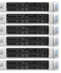
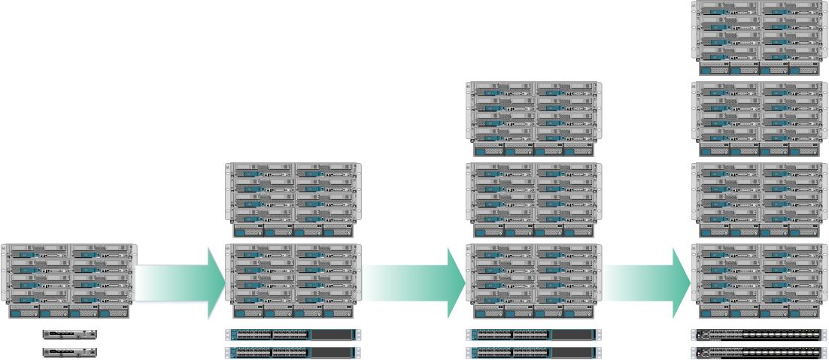
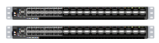
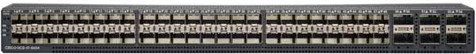






ARCHITECT ONCE, INNOVATE CONTINUOUSLY
Blade or Rack
Scale Resources Independently
Scale for Performance
Scale for Capacity
Completely Non-Disruptive
FI6324
FI6248
FI6332-16UP
FI6454
//X10 R2
>50 TB in 3U
//X20 R2
>250 TB in 3U
//X50 R2
>600 TB in 5U
//X70 R2
>1.2 PB in 3U
//X90 R2
>3 PB in 6U
//X90 R3
3 PB+ in 6U
7 x BLADES
>591 TB in 4U
9 x BLADES
>854 TB in 4U
15 x BLADES
>1.6 PB in 4U
LINEARLY SCALE TO 75 x BLADES
>6 PB in 20U
Notes:
This shows innovation without Rearchitecture.

Slide 7
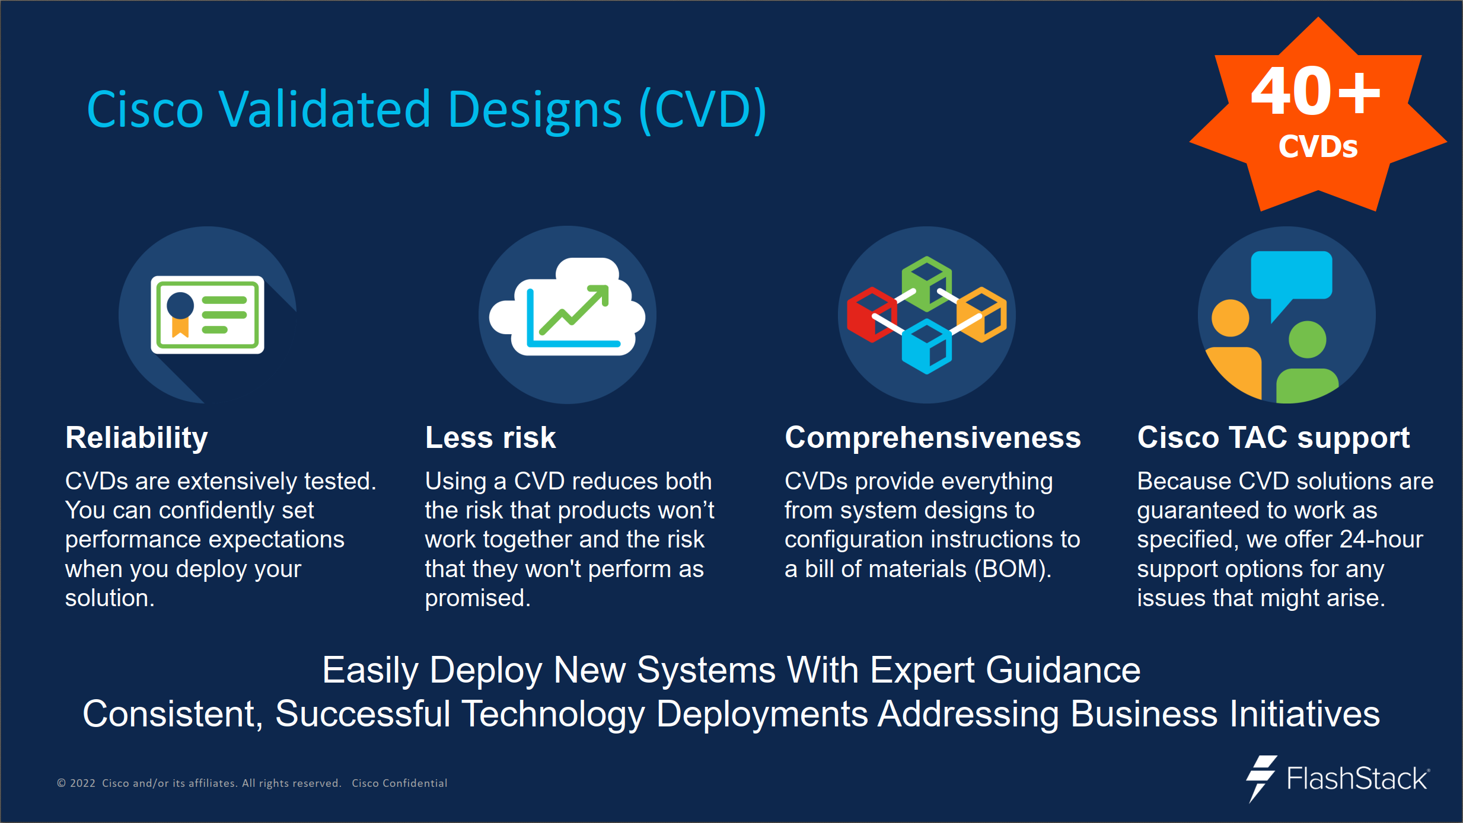

Slide 8
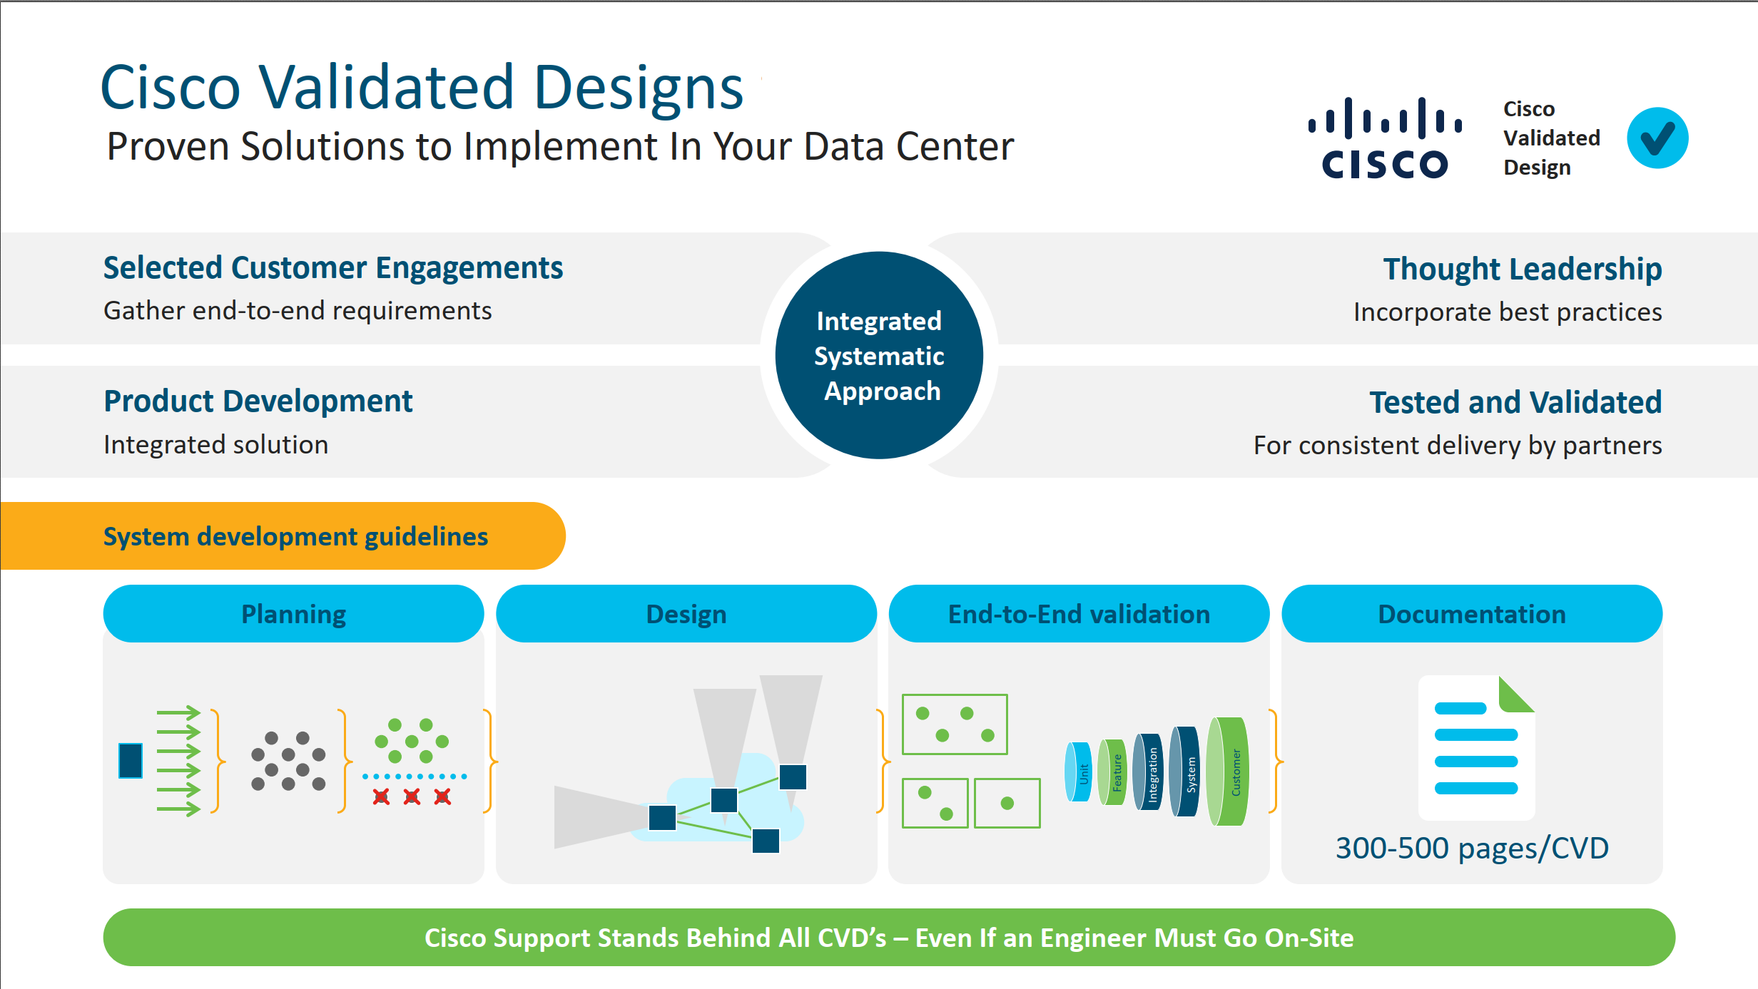

Slide 9
What is Infrastructure as Code?
“Infrastructure as code (IaC) is the management of infrastructure in a descriptive model, using a versioning system that is similar to what is used for source code.
An IaC model generates the same environment every time it is applied.
IaC is a key DevOps practice, and it is often used in conjunction with continuous delivery.
Ultimately, IaC allows you and your team to develop and release changes faster, but with much higher confidence in your deployments.”

Slide 10
Does this mean that…
I need to run everything in a CI/CD pipeline?
I need to find a specific tool?
I need to only deploy infrastructure in an automated fashion?

Slide 11
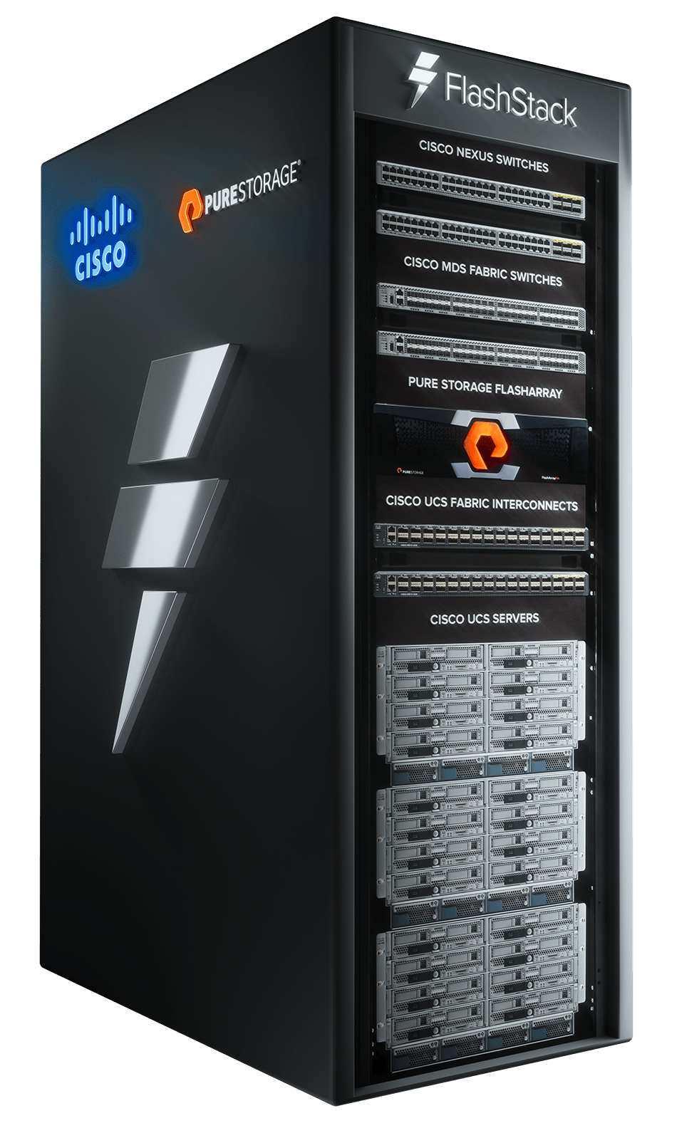
Why start your IaC journey with FlashStack?

Slide 12
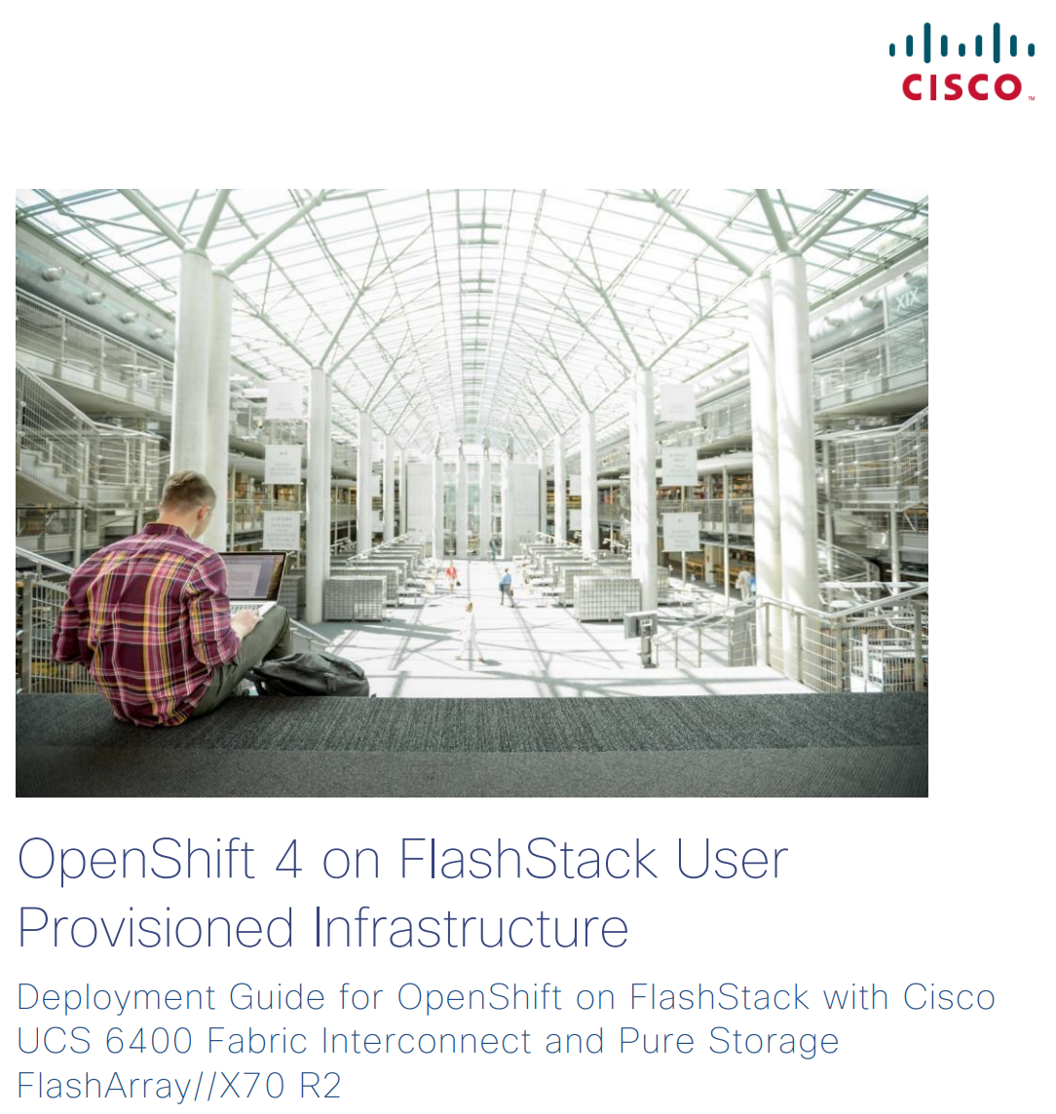
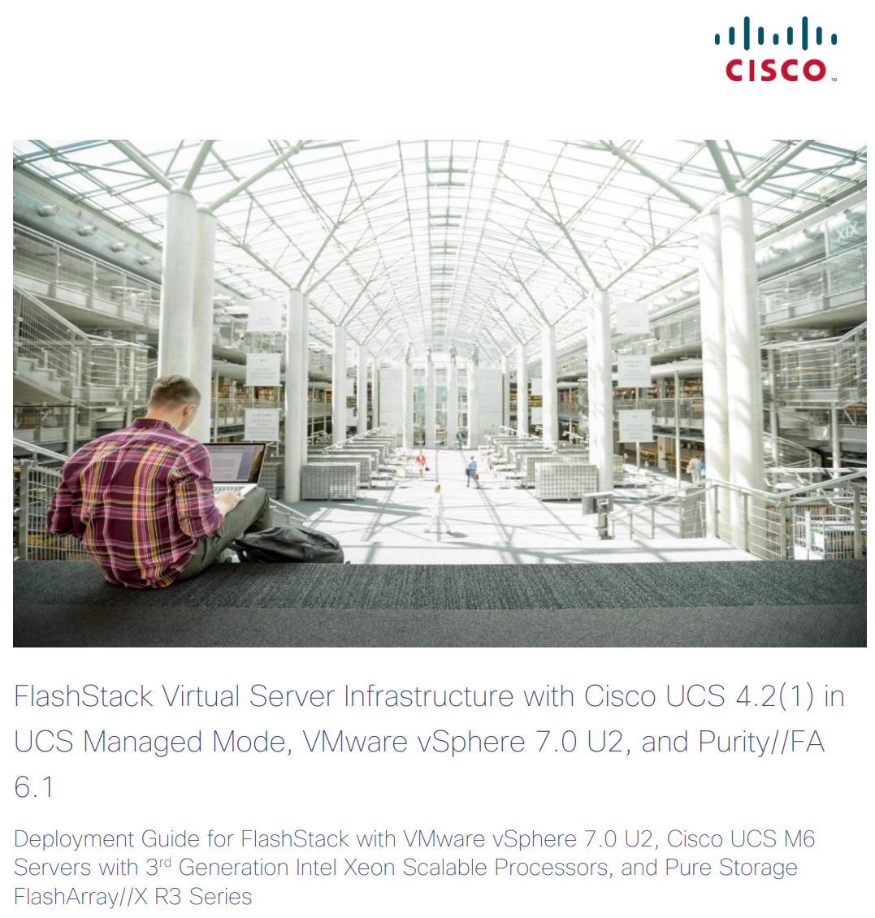
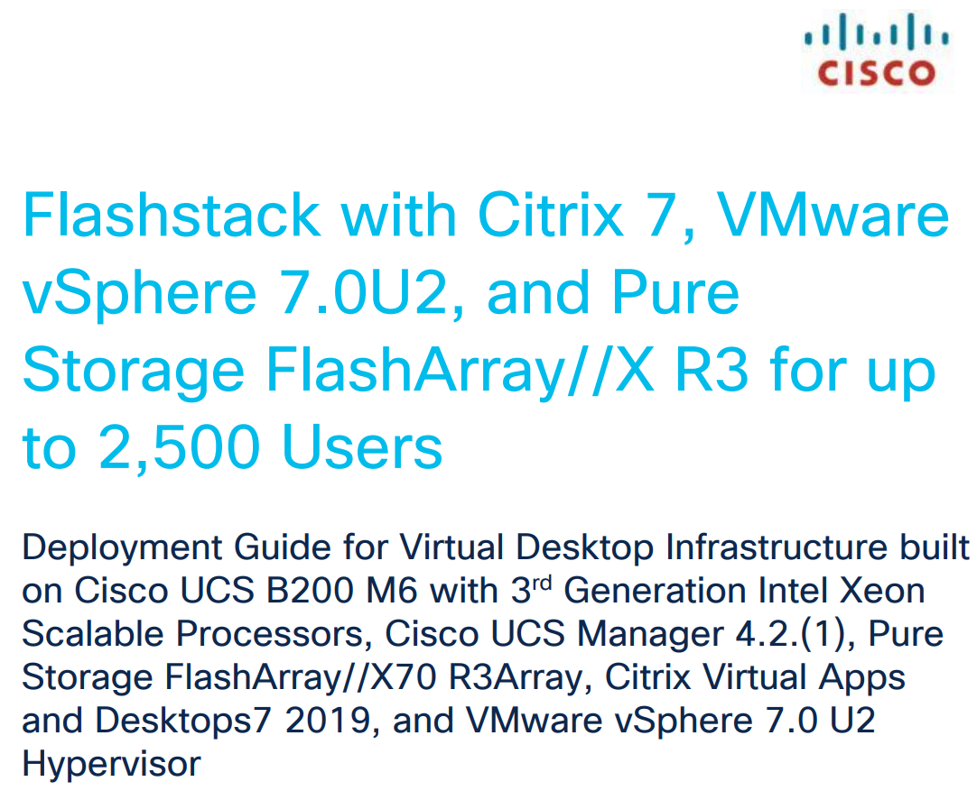
CVDs including Infrastructure as Code
OpenShift
76 Pages
vSphere
350 Pages
Citrix + vSphere
518 Pages

Slide 13

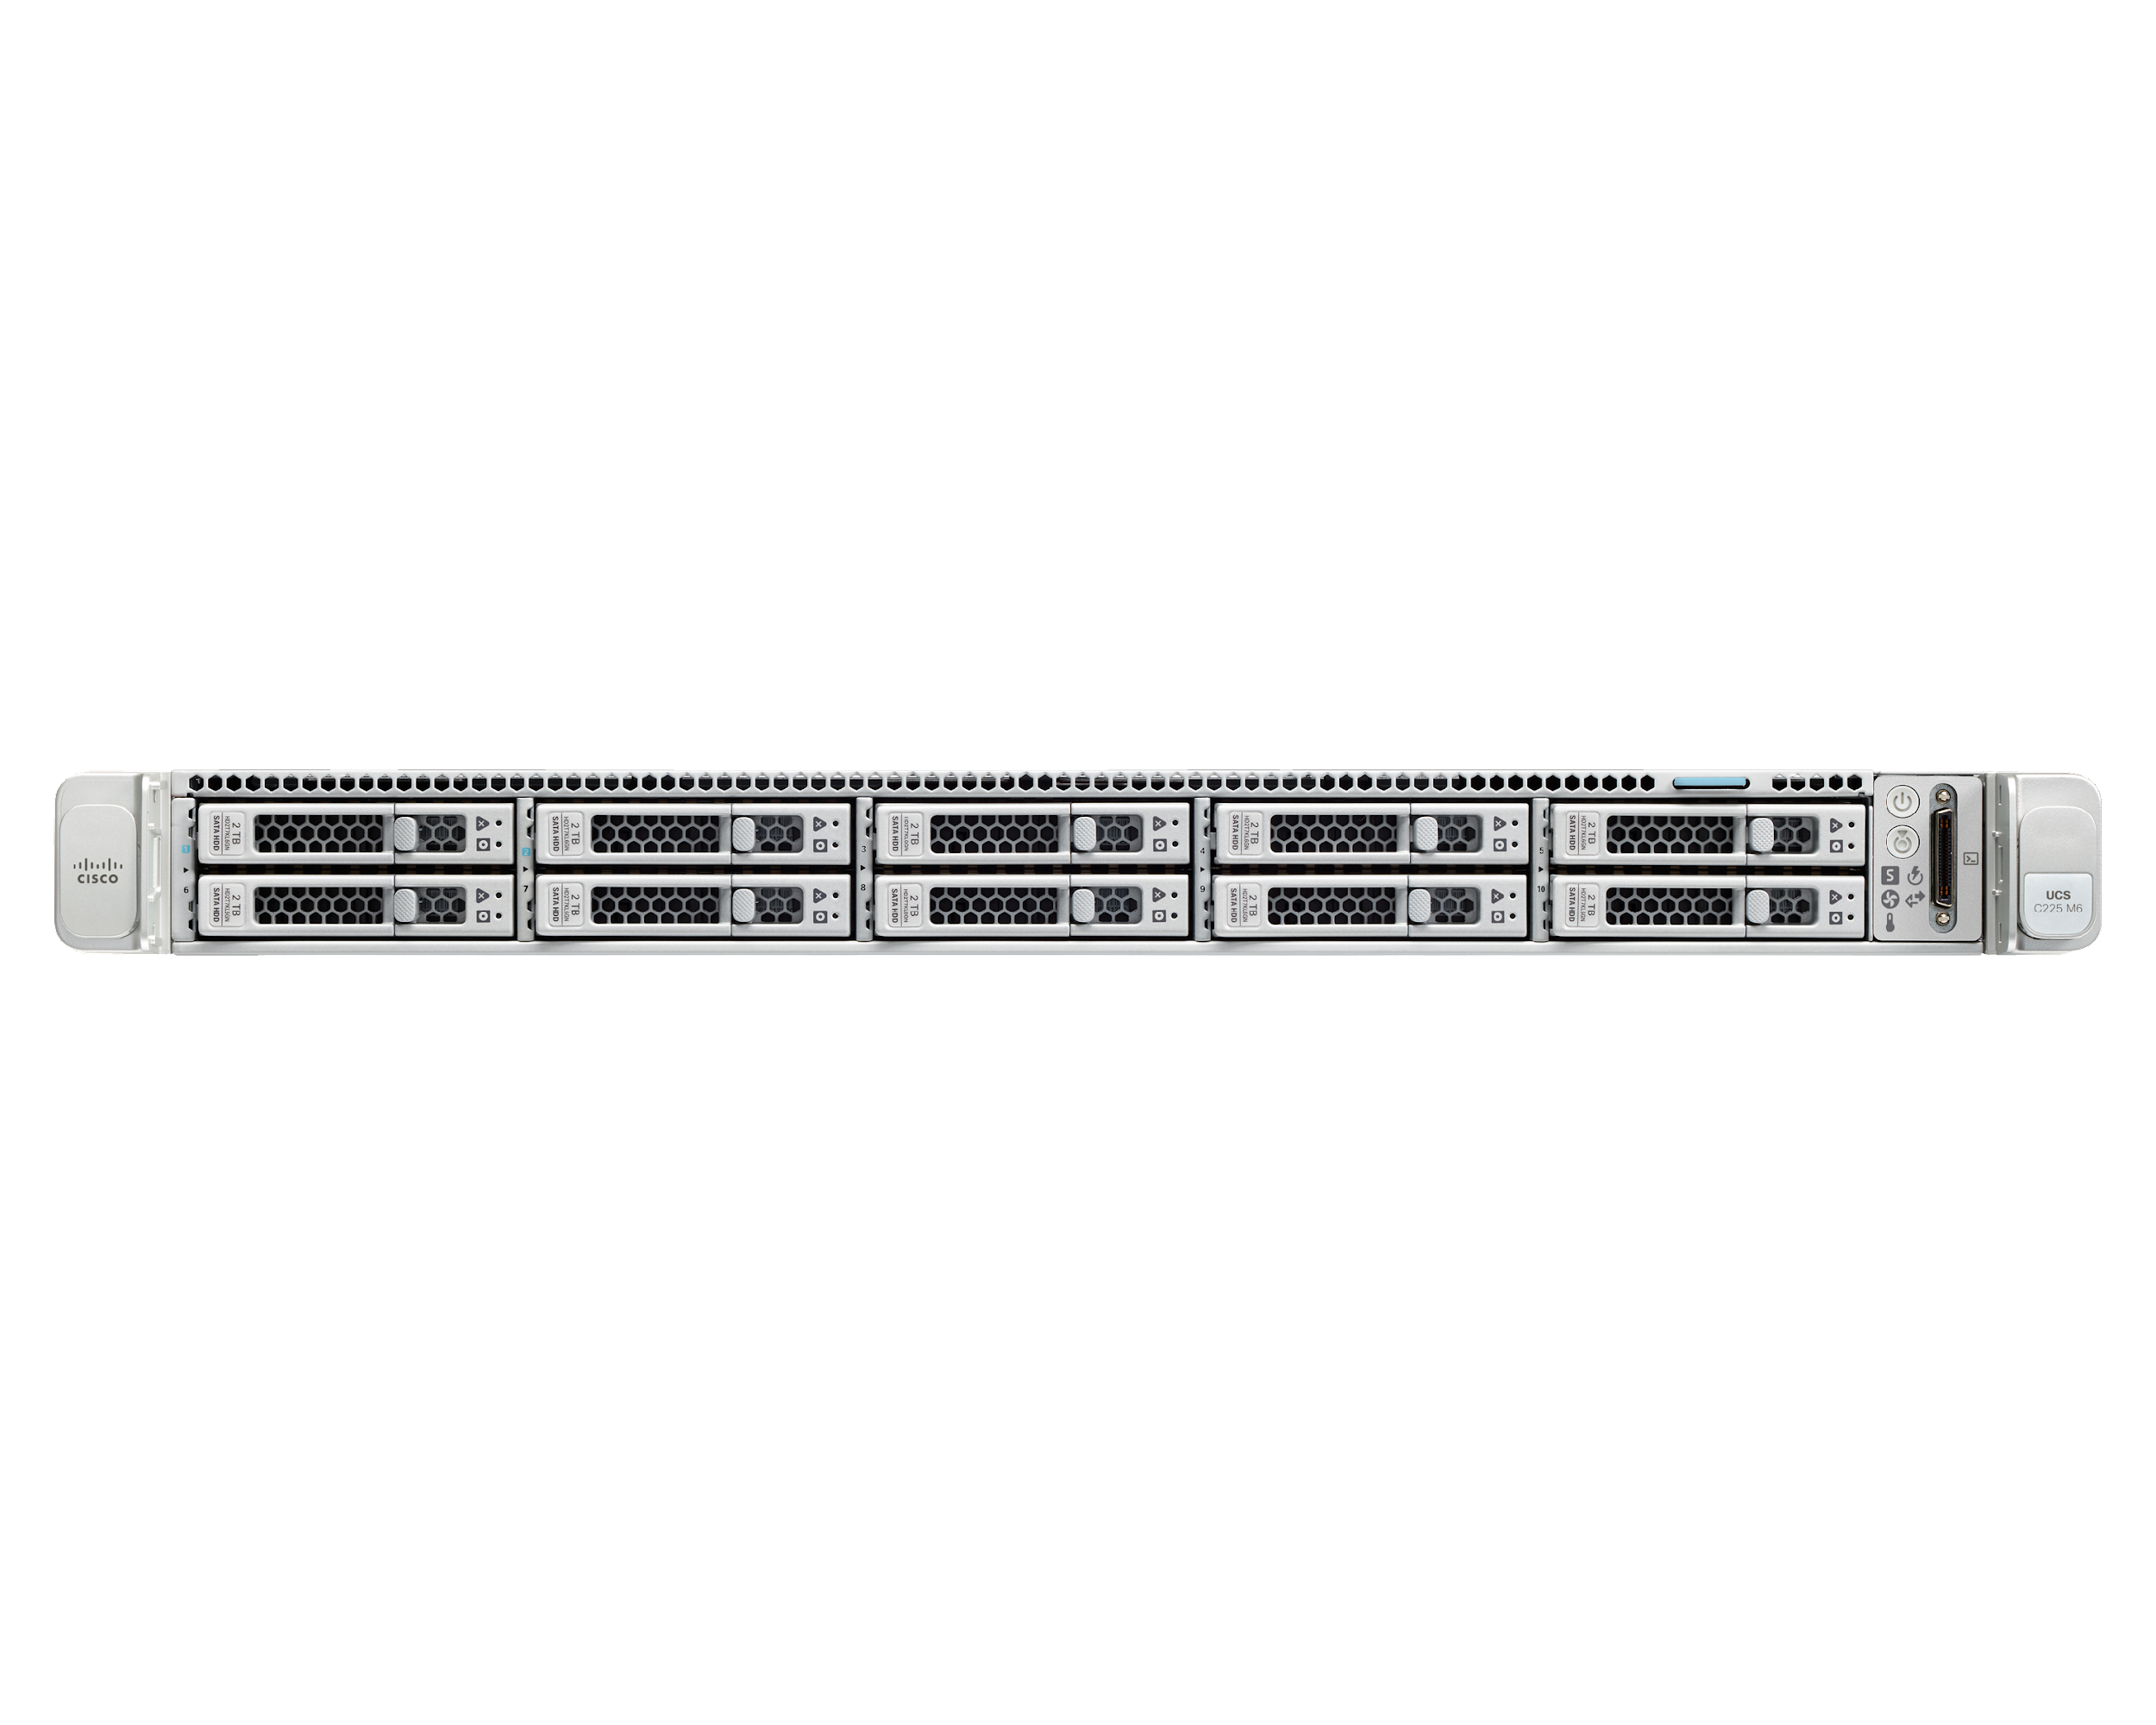
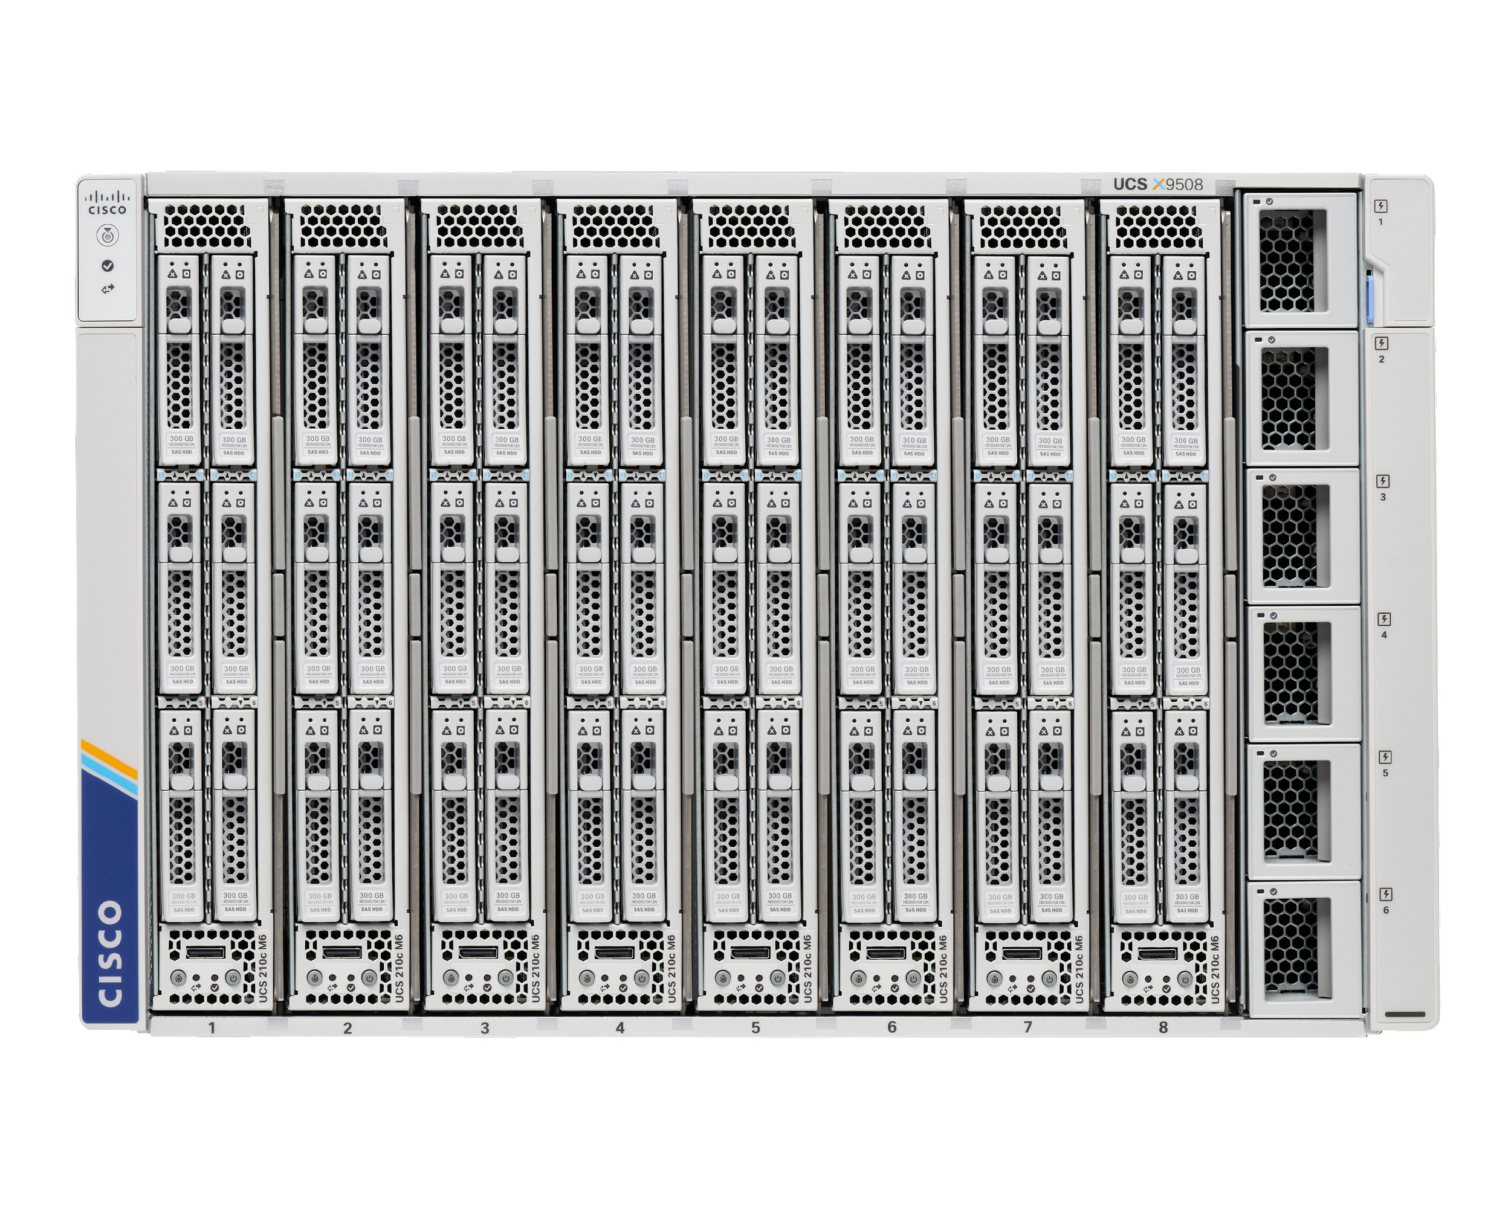
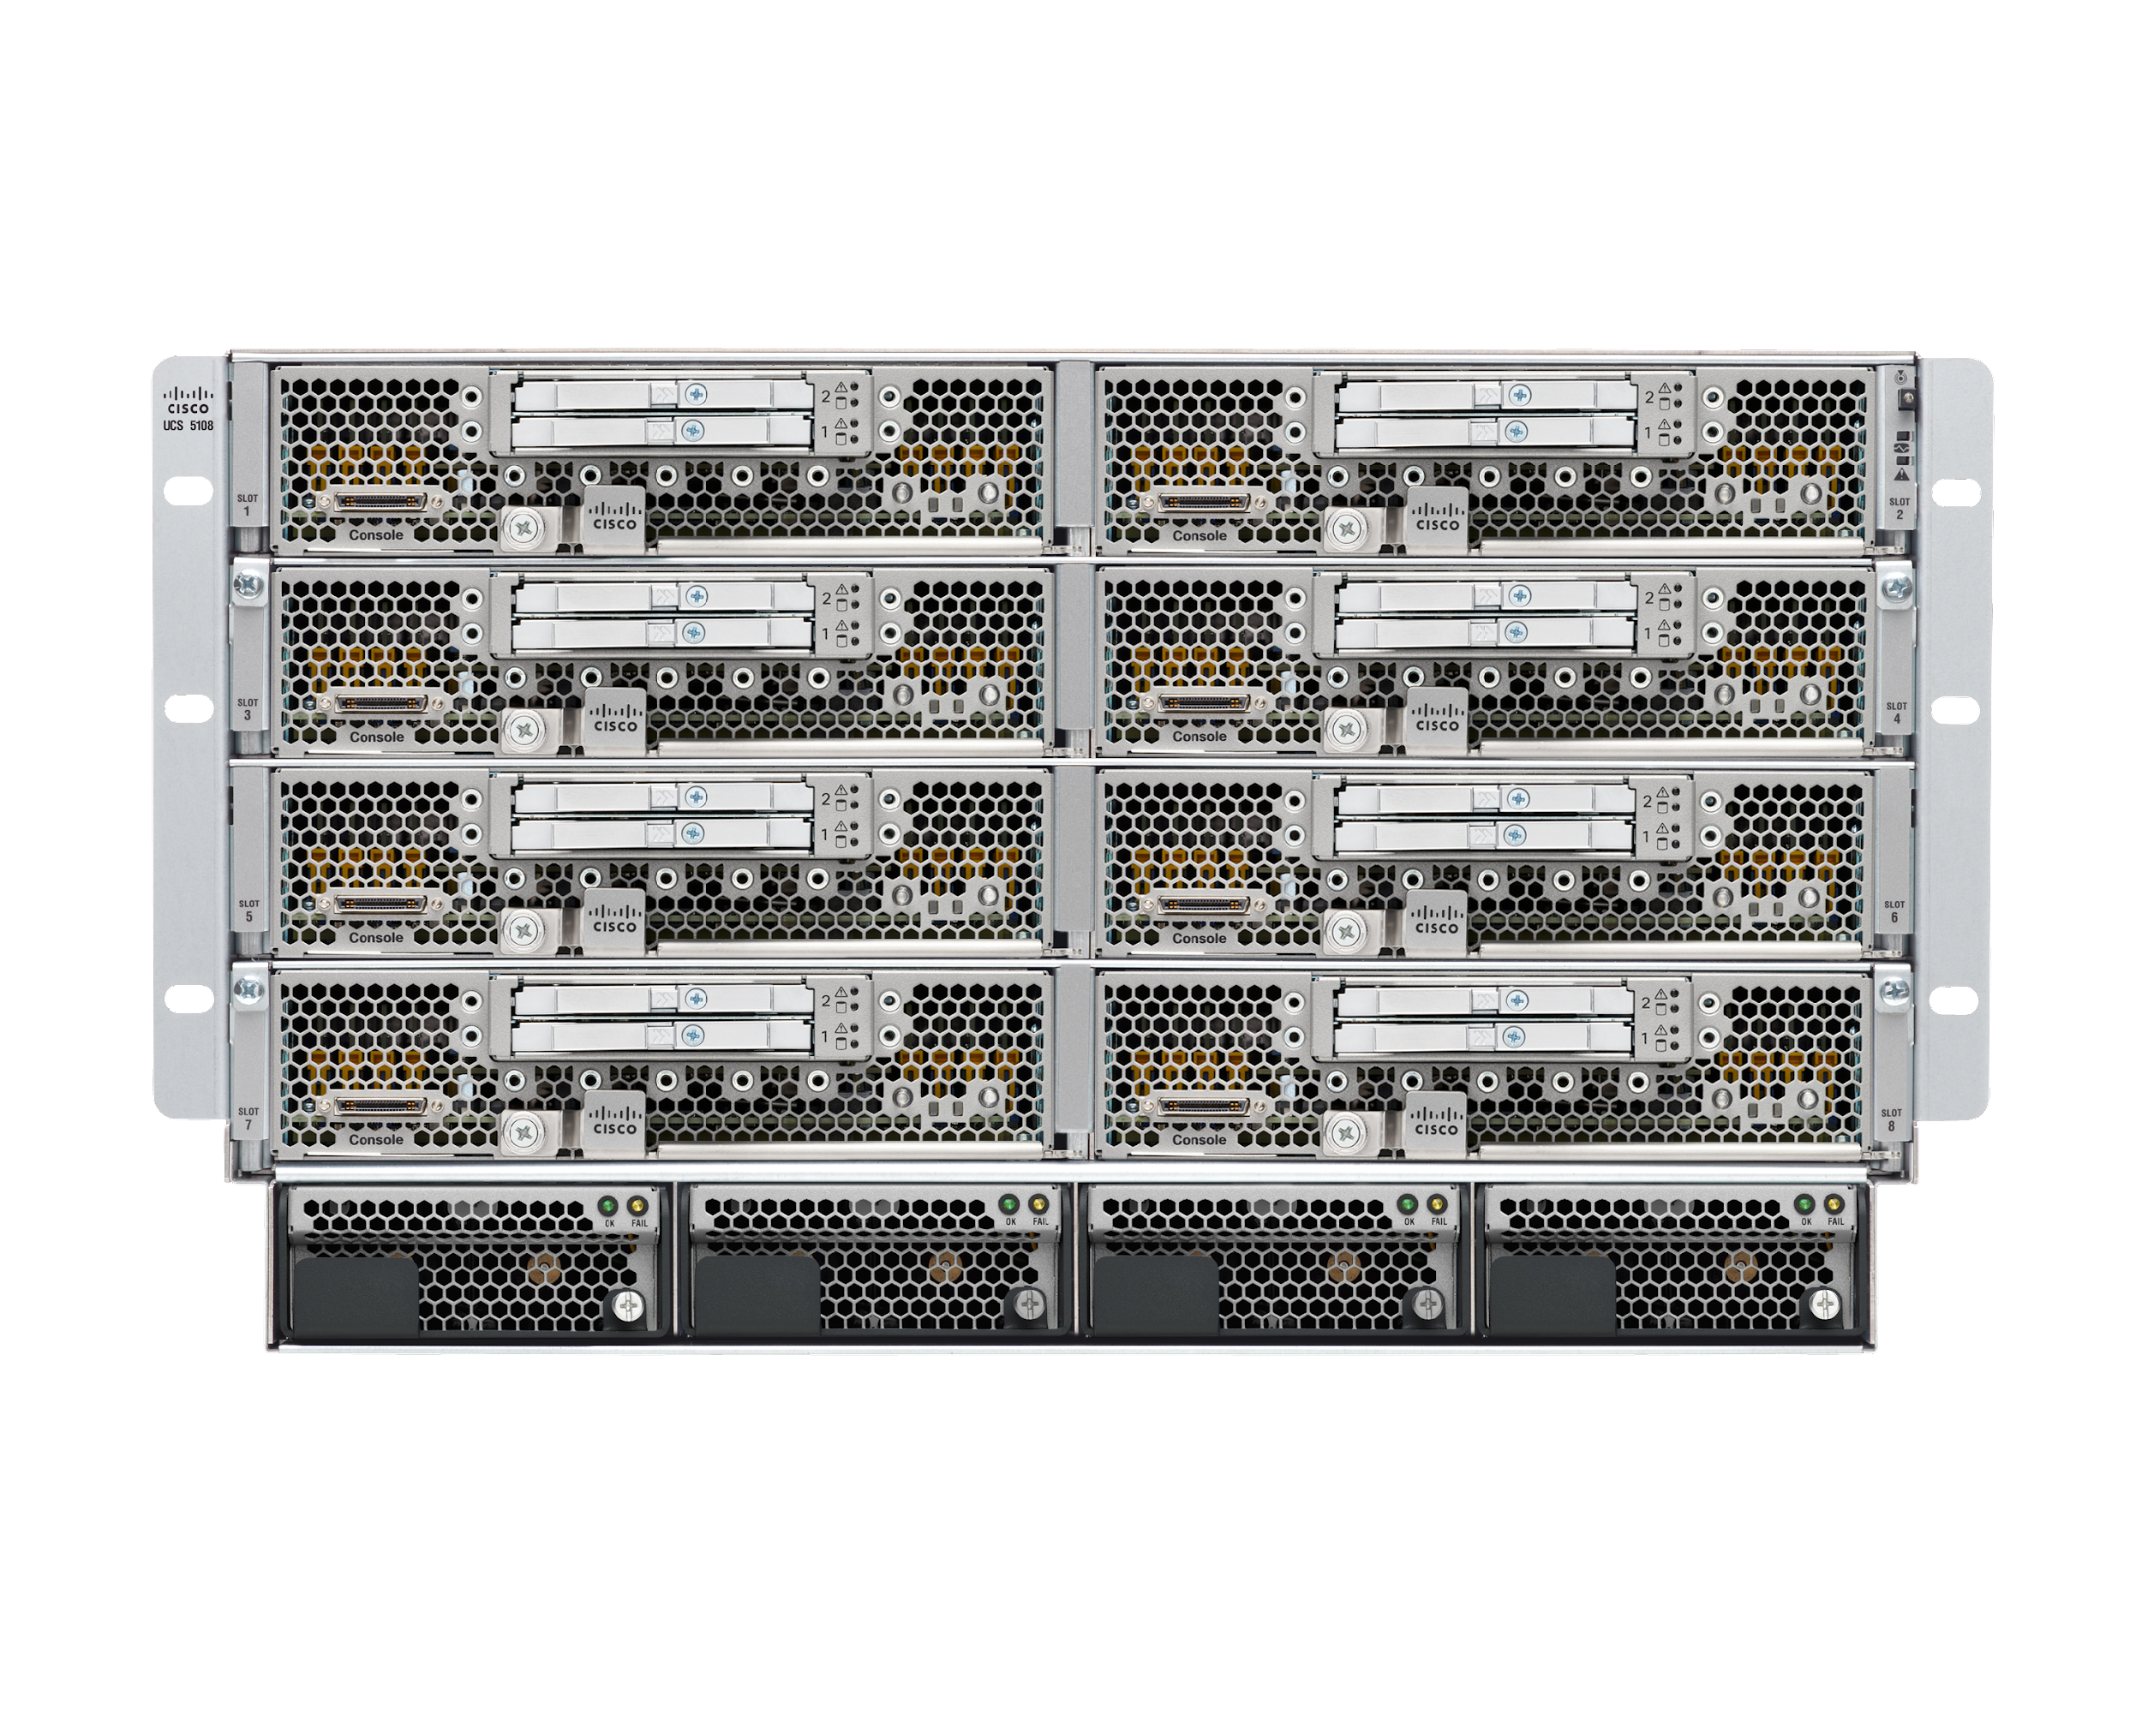
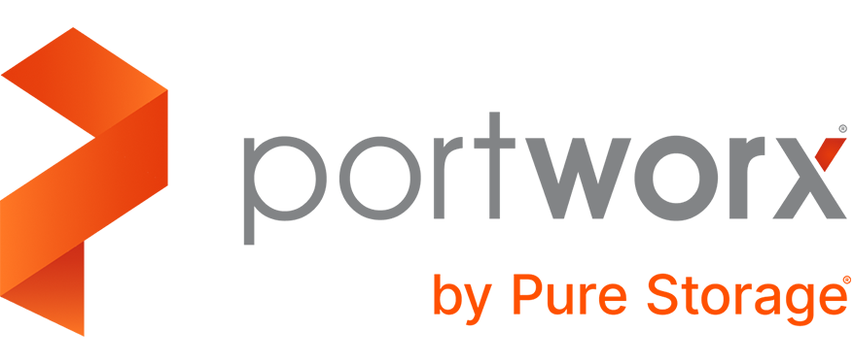
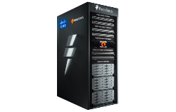
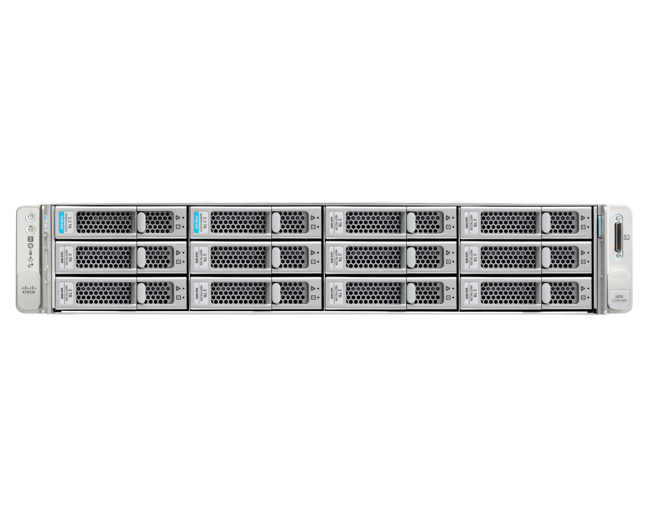

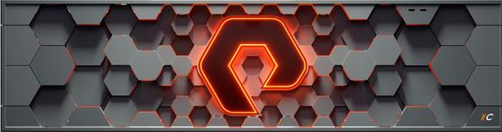
Hybrid cloud infrastructure for all apps / use cases
Cloud operations platform
X-Series
B-Series
C--Series
Containers and Cloud
FlashArray
FlashBlade
FlashStack
Virtual
Infrastructures
Hybrid Cloud
Enterprise
Applications
AI/ML
SAP HANA
Desktop
Virtualization
Data
Protection
Remote/Branch
Offices
FlashStack Solution Portfolio
Edge
Data center
Public clouds
Notes:
What makes Cisco’s approach to computing very different from anything else you see in the industry today is our SaaS-based approach to systems management. We believe that in a world of hyper-distributed applications, infrastructure and IT teams... that Management and orchestration belongs in the cloud. Cisco Intersight connects infrastructure and and operators anywhere, enabling global reach and scale.
With Intersight you get
Connected, Proactive support
Intelligent recommendations
Workload optimization and Kubernetes services that span on-prem and public cloud
and perhaps most importantly, an ongoing stream of innovation, delivered with SaaS simplicity from the cloud ,
taking the burden of maintaining systems management and orchestration software and hardware off your team’s plate.

Slide 14



Intersight Cloud Services
Private Cloud
Public Cloud
Intersight
Cloud Orchestrator
Intersight
Workload Optimizer
Intersight Service for HashiCorp Terraform
Automation
SSO
RBAC
Multi-tenancy
Inventory
SDK
…
Intersight Kubernetes Service
& Service Mesh Manager
Common Services
Cisco Virtualized Kubernetes
(w/ Intersight Workload Engine)
Bare Metal
Kubernetes
Observability
Intersight Infrastructure Service
Compute
Storage
Networking
3rd Party Infra
Cloud native
Notes:
This is the standard Intersight marketecture with product names.
You can use this slide to talk over the services that Intersight provides, linked to the capabilities in the previous slide.
It is a modular platform of integrated SaaS offerings that address your unique requirements and use cases, from managing Cisco data center and 3rd party infrastructure to executing complex workflows for workloads and applications in public clouds.

Slide 15
What are the real benefits of Infrastructure as Code?
Speed, performance, simplicity
Consistent results
Minimizing risk
Increased efficiency
Cost savings

Slide 16
What are some good practices for Infrastructure as Code?
Everything in code
Documentation in the system
Maintain control
Make it modular
Test often

Slide 17
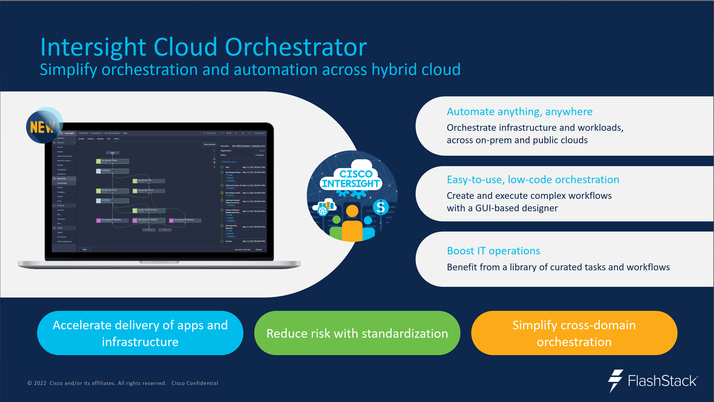

Slide 18



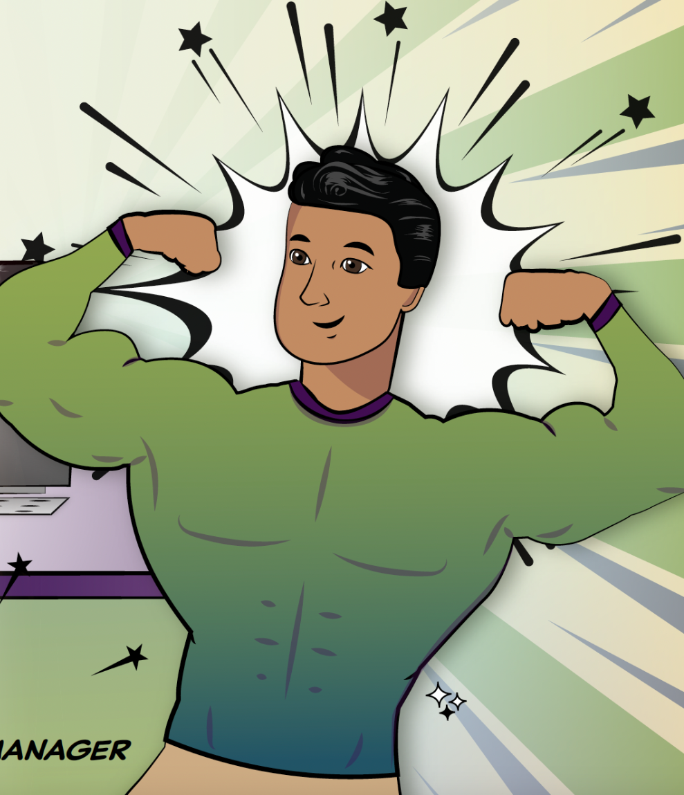
Conclusion:
Fewer Nerd Knobs
Rapid deployment via IaC
Francois FlashStack

Slide 19
And ALWAYS more Voltron FlashStack
UCS B200 + UCSM
UCS X-Series + Intersight
#1 UCS-based full stack solution!

